Slide 2
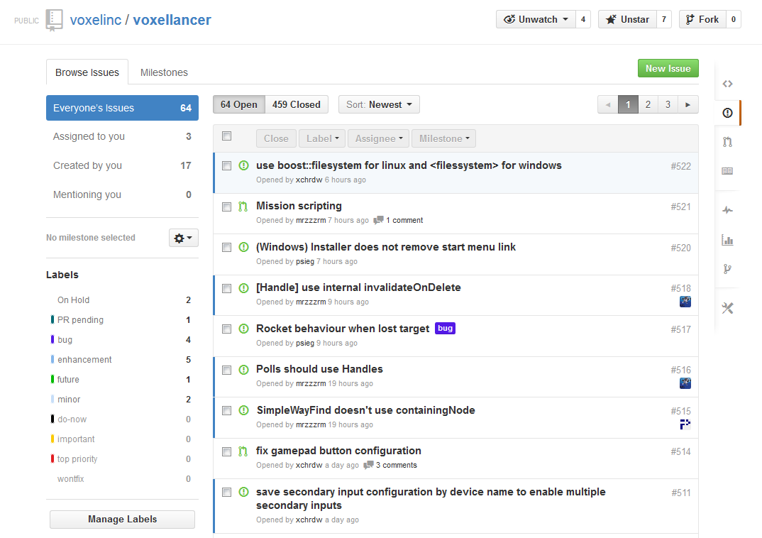
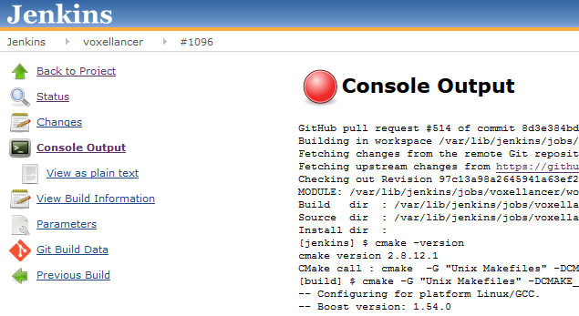
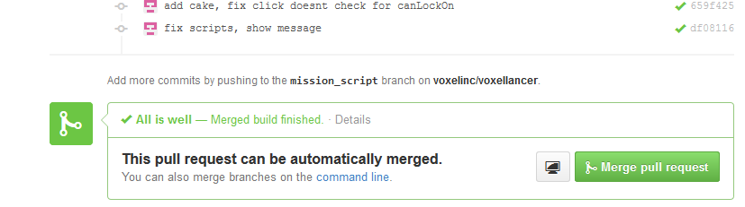
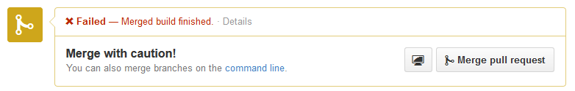
GitHub Workflow
GitHub Issues
Pull Requests and 4-Eyes-Review
GitHub-Jenkins Integration
Weekly team meetings

Slide 3
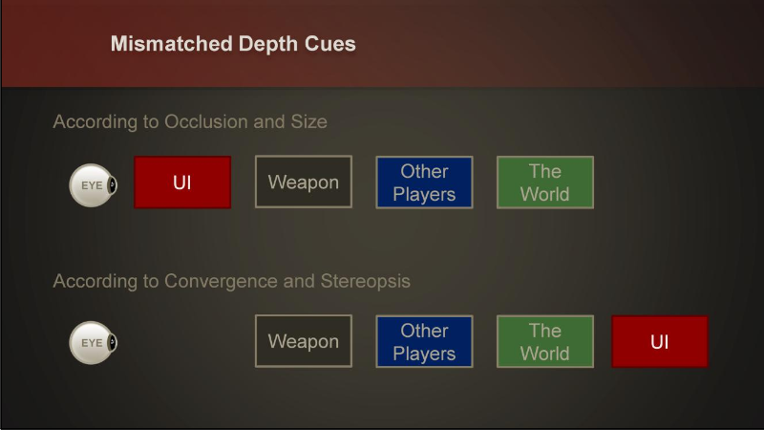
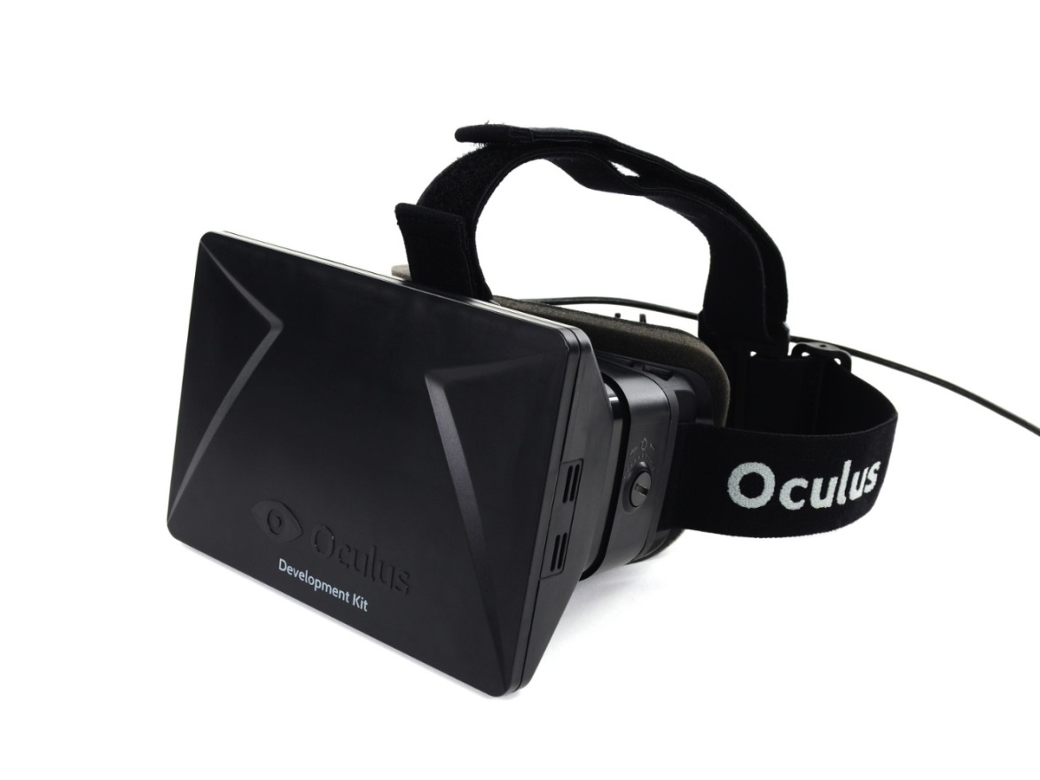
Issues: HUD and Oculus Rift
→ Spherical HUD around the player head

Slide 4

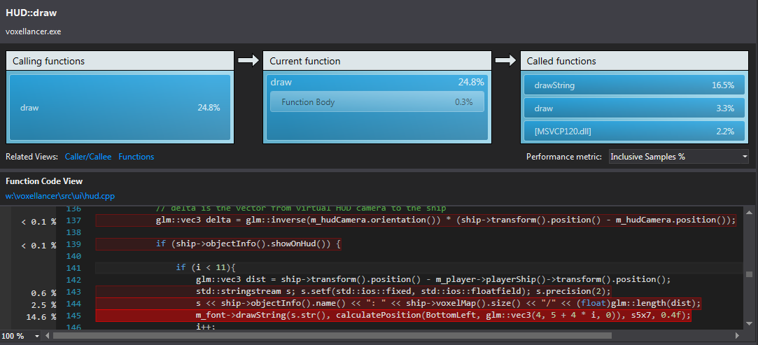
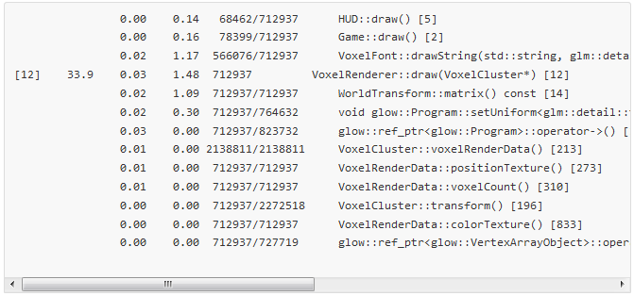
Issues: Performance
Debug mode, especially on windows, things can get very slow
Different performance behaviour on different OS and hardware platforms
→ Slow down whole game to maintain playability and keep developing other features
→ Include debug symbols in Release mode to keep debugging crashes

